Slide 1
CHAPTER 2:
Describing Distributions with Numbers
The Basic Practice of Statistics
6th Edition
Moore / Notz / Fligner
Lecture PowerPoint Slides
Notes:
Basic Practice of Statistics - 3rd Edition
Chapter 5

Slide 2
Chapter 2 Concepts
Measuring Center: Mean and Median
Measuring Spread: Quartiles
Five-Number Summary and Boxplots
Spotting Suspected Outliers
Measuring Spread: Standard Deviation
Choosing Measures of Center and Spread

Slide 3
Chapter 2 Objectives
Calculate and Interpret Mean and Median
Compare Mean and Median
Calculate and Interpret Quartiles
Construct and Interpret the Five-Number Summary and Boxplots
Determine Suspected Outliers
Calculate and Interpret Standard Deviation
Choose Appropriate Measures of Center and Spread
Organize a Statistical Problem

Slide 4

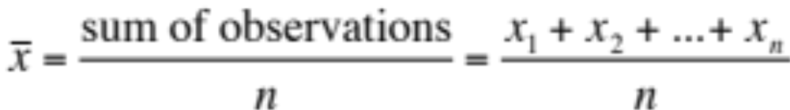
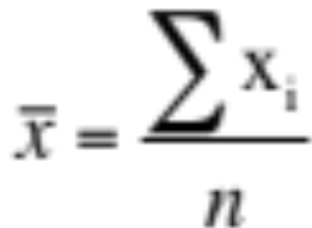
Measuring Center: The Mean
The most common measure of center is the arithmetic average, or mean.
To find the mean (pronounced “x-bar”) of a set of observations, add their values and divide by the number of observations. If the n observations are x₁, x₂, x₃, …, x_{n}, their mean is:
or in more compact notation

Slide 5
Measuring Center: The Median
Because the mean cannot resist the influence of extreme observations, it is not a resistant measure of center.
Another common measure of center is the median.
The median M is the midpoint of a distribution, the number such that half of the observations are smaller and the other half are larger.
To find the median of a distribution:
Arrange all observations from smallest to largest.
If the number of observations n is odd, the median M is the center observation in the ordered list.
If the number of observations n is even, the median M is the average of the two center observations in the ordered list.

Slide 6
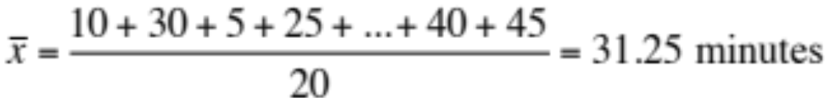

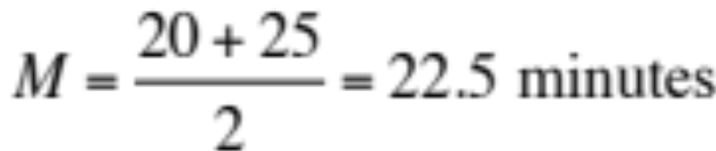
Measuring Center
  Use the data below to calculate the mean and median of the commuting times (in minutes) of 20 randomly selected New York workers.
0 5
1 005555
2 0005
3 00
4 005
5
6 005
7
8 5
Key: 4|5 represents a New York worker who reported a 45-minute travel time to work.

Slide 7
Comparing the Mean and Median
The mean and median measure center in different ways, and both are useful.
Comparing the Mean and the Median
The mean and median of a roughly symmetric distribution are close together.
If the distribution is exactly symmetric, the mean and median are exactly the same.
In a skewed distribution, the mean is usually farther out in the long tail than is the median.

Slide 8
Measuring Spread: Quartiles
  A measure of center alone can be misleading.
  A useful numerical description of a distribution requires both a measure of center and a measure of spread.
How to Calculate the Quartiles and the Interquartile Range
To calculate the quartiles:
Arrange the observations in increasing order and locate the median M.
The first quartile Q₁ is the median of the observations located to the left of the median in the ordered list.
The third quartile Q₃ is the median of the observations located to the right of the median in the ordered list.
The interquartile range (IQR) is defined as: IQR = Q₃ – Q₁

Slide 9
Five-Number Summary
The minimum and maximum values alone tell us little about the distribution as a whole. Likewise, the median and quartiles tell us little about the tails of a distribution.
To get a quick summary of both center and spread, combine all five numbers.
The five-number summary of a distribution consists of the smallest observation, the first quartile, the median, the third quartile, and the largest observation, written in order from smallest to largest.
Minimum Q₁ M Q₃ Maximum

Slide 10
Boxplots
The five-number summary divides the distribution roughly into quarters. This leads to a new way to display quantitative data, the boxplot.
How to Make a Boxplot
Draw and label a number line that includes the range of the distribution.
Draw a central box from Q₁ to Q₃.
Note the median M inside the box.
Extend lines (whiskers) from the box out to the minimum and maximum values that are not outliers.

Slide 11

Suspected Outliers: The 1.5 × IQR Rule
In addition to serving as a measure of spread, the interquartile range (IQR) is used as part of a rule of thumb for identifying outliers.
The 1.5 × IQR Rule for Outliers
Call an observation an outlier if it falls more than 1.5 × IQR above the third quartile or below the first quartile.
In the New York travel time data, we found Q₁ = 15 minutes, Q₃ = 42.5 minutes, and IQR = 27.5 minutes.
For these data, 1.5 × IQR = 1.5(27.5) = 41.25
Q₁ – 1.5 × IQR = 15 – 41.25 = –26.25
Q₃+ 1.5 × IQR = 42.5 + 41.25 = 83.75
Any travel time shorter than −26.25 minutes or longer than 83.75 minutes is considered an outlier.
0 5
1 005555
2 0005
3 00
4 005
5
6 005
7
8 5

Slide 12



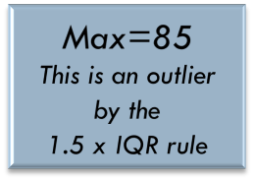
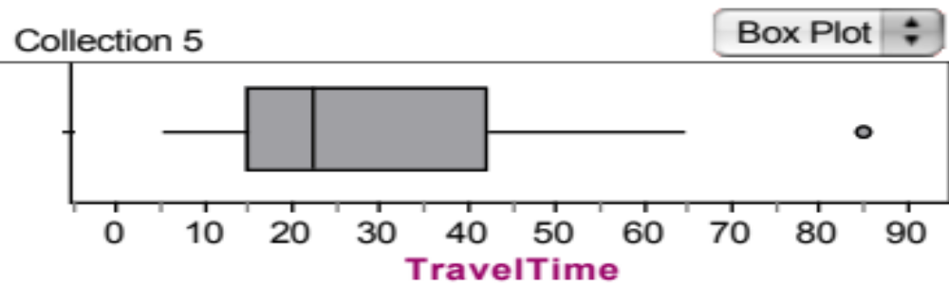
Boxplots
Consider our NY travel times data. Construct a boxplot.
10 | 30 | 5 | 25 | 40 | 20 | 10 | 15 | 30 | 20 | 15 | 20 | 85 | 15 | 65 | 15 | 60 | 60 | 40 | 45
5 | 10 | 10 | 15 | 15 | 15 | 15 | 20 | 20 | 20 | 25 | 30 | 30 | 40 | 40 | 45 | 60 | 60 | 65 | 85
M = 22.5

Slide 13
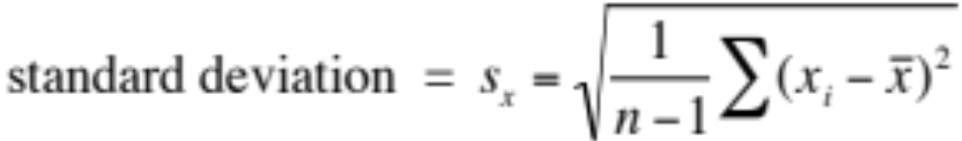
Measuring Spread: Standard Deviation
The most common measure of spread looks at how far each observation is from the mean. This measure is called the standard deviation.
The standard deviation s_{x} measures the average distance of the observations from their mean. It is calculated by finding an average of the squared distances and then taking the square root. This average squared distance is called the variance.

Slide 14
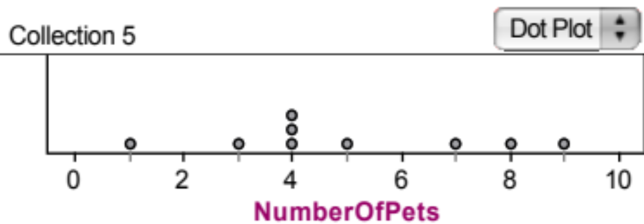

Calculating the Standard Deviation
Example: Consider the following data on the number of pets owned by a group of nine children.
Calculate the mean.
Calculate each deviation.
    deviation = observation – mean
deviation: 1 - 5 = -4
deviation: 8 - 5 = 3
= 5

Slide 15

Calculating the Standard Deviation
x_{i} | (x_{i}-mean) | (x_{i}-mean)²
1 | 1 - 5 = -4 | (-4)² = 16
3 | 3 - 5 = -2 | (-2)² = 4
4 | 4 - 5 = -1 | (-1)² = 1
4 | 4 - 5 = -1 | (-1)² = 1
4 | 4 - 5 = -1 | (-1)² = 1
5 | 5 - 5 = 0 | (0)² = 0
7 | 7 - 5 = 2 | (2)² = 4
8 | 8 - 5 = 3 | (3)² = 9
9 | 9 - 5 = 4 | (4)² = 16
 | Sum=? | Sum=?
3) Square each deviation.
4) Find the “average” squared deviation. Calculate the sum of the squared deviations divided by (n-1)…this is called the variance.
5) Calculate the square root of the variance…this is the standard deviation.
“Average” squared deviation = 52/(9-1) = 6.5 This is the variance.
Standard deviation = square root of variance =

Slide 16
Choosing Measures of Center and Spread
We now have a choice between two descriptions for center and spread
  Mean and Standard Deviation
  Median and Interquartile Range
Choosing Measures of Center and Spread
The median and IQR are usually better than the mean and standard deviation for describing a skewed distribution or a distribution with outliers.
Use mean and standard deviation only for reasonably symmetric distributions that don’t have outliers.
NOTE: Numerical summaries do not fully describe the shape of a distribution. ALWAYS PLOT YOUR DATA!

Slide 17
Organizing a Statistical Problem
As you learn more about statistics, you will be asked to solve more complex problems.
Here is a four-step process you can follow.
How to Organize a Statistical Problem: A Four-Step Process
State: What’s the practical question, in the context of the real-world setting?
Plan: What specific statistical operations does this problem call for?
Do: Make graphs and carry out calculations needed for the problem.
Conclude: Give your practical conclusion in the setting of the real-world problem.
Notes:
Basic Practice of Statistics - 3rd Edition
Chapter 5

Slide 18
Chapter 2 Objectives Review
Calculate and Interpret Mean and Median
Compare Mean and Median
Calculate and Interpret Quartiles
Construct and Interpret the Five-Number Summary and Boxplots
Determine Suspected Outliers
Calculate and Interpret Standard Deviation
Choose Appropriate Measures of Center and Spread
Organize a Statistical Problem

